Slide 1
Thank you sponsors!
Headway Emotional Health Services
With more than 40 years in operation, Headway’s 150 plus caring staff in Golden Valley, Richfield, Brooklyn Center and Hopkins provide comprehensive mental health therapy, counseling and classes to more than 45,000 families each year. www.headway.org
Cambia Hills, Woodland Hills and Neighborhood Youth Services
Woodland Hills, located on a 140-acre campus in Duluth, Minnesota, specializes in mental health, community-based services, and juvenile justice programs for young people. We promote behavioral, mental and chemical health as well as physical well-being, while showing kids and young adults, parents and guardians that they are not alone in the fight toward healthy, well-balanced lives. www.woodlandhills.org
Prairie St. Johns
Located in Fargo, ND and founded in 1997, Prairie St. John’s is a fully-licensed and accredited 91-inpatient bed facility offering services for children, adolescents and adults to address mental health issues, chemical dependency addiction or co-occurring disorders. www.prairie-stjohns.com

Slide 2
Juvenile Justice 21
A Roadmap for Juvenile Justice in the 21st Century
Mental Health and Collaboration

Slide 3
Juvenile justice 21
The Minnesota Corrections Association will convene juvenile justice stakeholders throughout Minnesota with the goal of identifying a unified vision for the future of juvenile justice in Minnesota.
Funded by the Juvenile Justice and Delinquency Prevention Act through the Minnesota Juvenile Justice Advisory Committee and Minnesota Department of Public Safety Office of Justice Programs.

Slide 4
Jj21 2014 AREAS of recommendation
Family Engagement;
Diversion, Alternatives to Detention and Reentry;
Mental Health and Substance Use;
School Collaboration;
Child Welfare Collaboration; and
Collateral Consequences of Records.

Slide 5
MENTAL HEALTH AND DELINQUENCY
65-70% of youth in juvenile justice placements have a diagnosable mental health disorder, compared to 15-20% in general population.

Slide 6
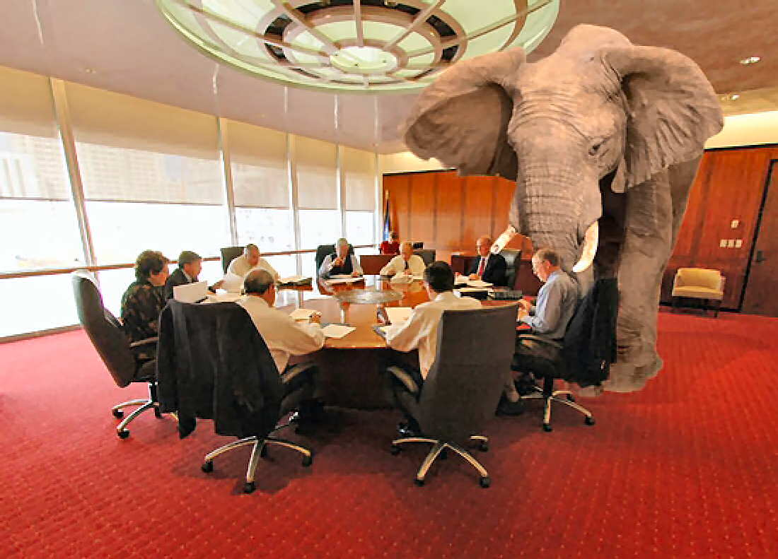
MENTAL HEALTH AND CHILDREN’S MENTAL HEALTH IN MINNESOTA

Slide 7
MENTAL HEALTH AND CHILDREN’S MENTAL HEALTH IN MINNESOTA
What is happening in mental health treatment in Minnesota? What are the challenges and what progress has been made and can we look forward to?
How has the ACA impacted mental health treatment in MN? For children specifically?
What are we doing to address the unique needs of children?
Why such a shortage of beds and psychiatric services?
How can Minnesota’s mental health system better respond to (and prevent) justice system involved children?

Slide 8
MENTAL HEALTH AND CHILDREN’S MENTAL HEALTH IN MINNESOTA
Sue Abderholden, NAMI Minnesota Bill Wyss, MN Dept. of Human Services

Slide 9
MENTAL HEALTH AND DELINQUENCY
Robert Kinscherff, PhD, Esq.
Faculty at the Center for Law, Brain and Behavior at Massachusetts General Hospital and Senior Associate for the National Center for Mental Health and Juvenile Justice.
https://youtu.be/P0vfGOJkpGY

Slide 10
Panel - Intervention
Janet Krueger, Public Defense Attorney, Olmsted County
Kate Richtman, Assistant County Attorney, Ramsey County
Curtis Shanklin, State Coordinator, JDAI
Hal Pickett, Director of Client Services, Headway Emotional Health

Slide 11
Panel - corrections
Travis Gransee, Director, Olmsted Community Corrections
Shon Thieren Associate Warden, MCF – Redwing
Anna Hewitt Mental Health Supervisor, Ramsey County JDC
Jeff Bradt CEO, Woodland Hills

Slide 12
Discussion 1
Introductions
What is most concerning to you about how our juvenile justice system responds to youth with mental health needs?
What is happening in your area that helps or hinders the response?
What would be most helpful for the state to do to better respond? Your county? You and/or your workplace?

Slide 13
Thank you sponsors!
Headway Emotional Health Services
With more than 40 years in operation, Headway’s 150 plus caring staff in Golden Valley, Richfield, Brooklyn Center and Hopkins provide comprehensive mental health therapy, counseling and classes to more than 45,000 families each year. www.headway.org
Cambia Hills, Woodland Hills and Neighborhood Youth Services
Woodland Hills, located on a 140-acre campus in Duluth, Minnesota, specializes in mental health, community-based services, and juvenile justice programs for young people. We promote behavioral, mental and chemical health as well as physical well-being, while showing kids and young adults, parents and guardians that they are not alone in the fight toward healthy, well-balanced lives. www.woodlandhills.org
Prairie St. Johns
Located in Fargo, ND and founded in 1997, Prairie St. John’s is a fully-licensed and accredited 91-inpatient bed facility offering services for children, adolescents and adults to address mental health issues, chemical dependency addiction or co-occurring disorders. www.prairie-stjohns.com

Slide 14
collaboration

Slide 15
Collaboration?

Slide 16
Collaboration?

Slide 17
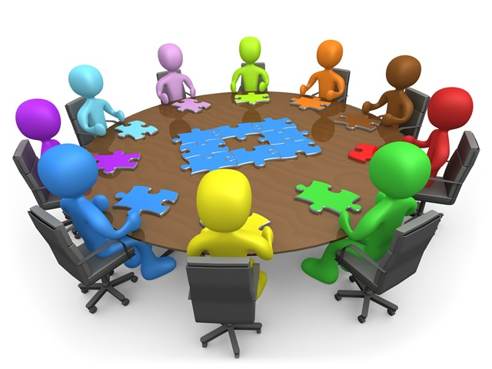
collaboration

Slide 18
collaboration
Who is at the table?

Slide 19
collaboration
Corrections
Mental Health
Social Services
Law Enforcement
Schools
Families

Slide 20
Corrections and social services collaboration
Crossover Youth, Dual Status Youth
Carver Co. Hennepin Co. Kandiyohi Co. Olmsted Co. Stearns Co.

Slide 21
DUAL STATUS Model Programs Panel
Richard Gardell Chair, Juvenile Justice Advisory Committee (Moderating)
Greg Boelter Stearns County Probation Supervisor
Dana Erickson Assistant Stearns County Attorney
Melissa Clemens Corrections Mental Health Case Manager, Olmsted County
Patrick McEvoy Olmsted County Social Services

Slide 22
Discussion 2
Introductions
Is your county using a crossover/dual status collaboration program? What have been the successes and/or challenges? What needs to be improved? If not, what would be needed to get it started?
How are you collaborating with the mental health system in your county?
Are you collaborating with other systems in your county?
How do you think you can do a better job of collaborating with other systems?

Slide 23
Recommendations
Blueprint for Change
Collaboration
Identification
Diversion
Treatment

Slide 24
Recommendations
Identification
Increase funding for and access to assessment.
Ensure 100% of screeners trained.
Clarify action taken based on screening results.
Diversion
Determine role of mental health in diversion eligibility.
Revisit offenses eligible for diversion.
Treatment
Fund community children’s mental health and chemical dependency services.
Fully fund support services in facilities.

Slide 25
Recommendations
Data Collection
Collect county-wide and statewide statistics.
Data Sharing - Confusion
Create task force on juvenile data sharing policies and procedures.
Guide on juvenile data sharing.
Recommended release forms.

Slide 26
Recommendations
Training
Make basic juvenile delinquency mental health training available statewide.
Train on local resources.
Racial Disparities
Provide implicit bias training.
Develop culturally competent programming.

Slide 27
Recommendations
Collaboration
Dual Status Youth
Provide information and training for more counties to develop crossover programs.
Networking and Information Sharing
Develop and manage list-serve.
Make “toolkit” available online and update.
Statutes
Resources
Minnesota and National Reports and Information

Slide 28
Juvenile Justice 21
Contact: Mark Haase Project Manager mahaase@gmail.com
www.mn-ca.org

